Slide 1
Cryptographic techniques
Adelaiye o. i.

Slide 2
Hash functions

Slide 3
INTRODUCTION
A hash function is a mathematical function that converts an input value into another compressed value.
The input to the hash function is of arbitrary length but output is always of fixed length.

Slide 4
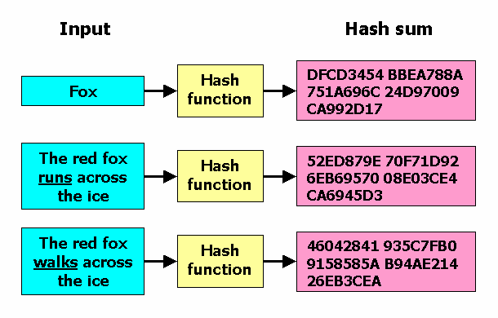

Slide 5
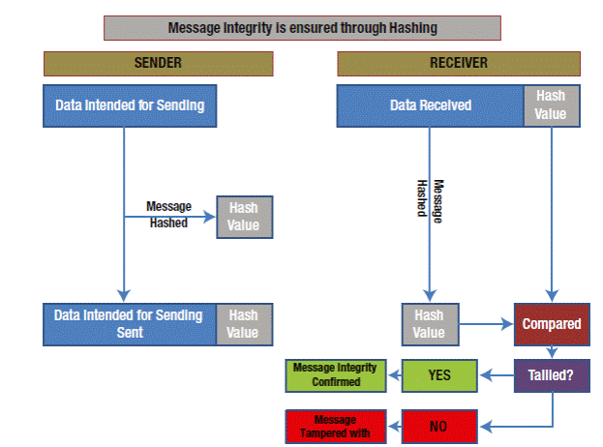

Slide 6
HASH FUNCTION ???
A one-way function
A one-way transformation
If h is a hash function such that y=h(x), then it is computationally infeasible for a user who has h and y to find x
Collision free
If h is a hash function such that y=h(x), then it is computationally infeasible for a user who has h and y to find an x’ such that h(x’)=y)
Gives a fixed length output, whatever the input size is
MD5’s is 128, SHA-1’s is 160
The output is aka hash, digest or checksum.
MD5: Message Digest 5
SHA-1: Secure Hash Algorithm

Slide 7
FEASIBLE OR NOT??
In theory, is it possible to find two strings with the same hash?
Yes ! Hash all possible 161 bit strings
In practice?
Computationally infeasible !
Is it possible to find m such that h(m)=H
In theory, yes !
In practice, computationally infeasible
Is finding two strings with the same hash of the same difficulty as finding one string matching a particular hash value?
Is finding m, m’ such that h(m)=h(m’) as difficult as finding m such that h(m)=H?

Slide 8
POPULAR ALGORITHMS
Message Digest (MD)
MD5 was most popular and widely used hash function for quite some years.
The MD family comprises of hash functions MD2, MD4, MD5 and MD6. It was adopted as Internet Standard RFC 1321. It is a 128-bit hash function.
MD5 digests have been widely used in the software world to provide assurance about integrity of transferred file. For example, file servers often provide a pre-computed MD5 checksum for the files, so that a user can compare the checksum of the downloaded file to it.
In 2004, collisions were found in MD5. An analytical attack was reported to be successful only in an hour by using computer cluster. This collision attack resulted in compromised MD5 and hence it is no longer recommended for use.

Slide 9
POPULAR ALGORITHMS (CONT’D)
Family of SHA comprise of four SHA algorithms; SHA-0, SHA-1, SHA-2, and SHA-3. Though from same family, there are structurally different.
The original version is SHA-0, a 160-bit hash function, was published by the National Institute of Standards and Technology (NIST) in 1993. It had few weaknesses and did not become very popular. Later in 1995, SHA-1 was designed to correct alleged weaknesses of SHA-0.
SHA-1 is the most widely used of the existing SHA hash functions. It is employed in several widely used applications and protocols including Secure Socket Layer (SSL) security.
In 2005, a method was found for uncovering collisions for SHA-1 within practical time frame making long-term employability of SHA-1 doubtful.

Slide 10
POPULAR ALGORITHMS (CONT’D)
SHA-2 family has four further SHA variants, SHA-224, SHA-256, SHA-384, and SHA-512 depending up on number of bits in their hash value. No successful attacks have yet been reported on SHA-2 hash function.
Though SHA-2 is a strong hash function. Though significantly different, its basic design is still follows design of SHA-1. Hence, NIST called for new competitive hash function designs.
In October 2012, the NIST chose the Keccak algorithm as the new SHA-3 standard. Keccak offers many benefits, such as efficient performance and good resistance for attacks.

Slide 11
THE BIRTHDAY PARADOX
What is the probability of picking someone whose birthday date is the 22nd of October?
1/365
If you have a group of n persons, what is the probability of picking 2 persons who have the same birthday?
You pick a first person
The probability that the second person does not have the same date of birth is 364/365
The probability that the third person does not have the date of birth of any of the first two is 363/365
…
The probability that the n^{th} person does not have the date of birth of any of the first (n-1) persons is (365-(n-1))/365
The probability that none of n persons have the same date of birth is
365𝑥𝑥𝑥𝑥𝑥…𝑥(365−(𝑛−1)/365
In particular, for n=23 persons, the probability that they all have different birthdays is: 365𝑥𝑥𝑥𝑥𝑥…𝑥(365−(22)/365 = 0.4927
That is, the probability that two persons have the same date of birth in a group of 23 persons is: 1-0.4927=0.5073

Slide 12
BIRTHDAY PARADOX
If you have 23 persons, two of them have the same date of birth with a probability higher than 0.5
More generally if you have n possible values, it is enough to have √n samples of these values in order to get two equal values with a probability higher than 0.5
Finding two messages with the same hash is similar to a Birthday problem !
Two messages 🡪 Two individuals
Same hash 🡪 Same birthday
For SHA-1 (2¹⁶⁰ possible hashes), it is enough to hash 2⁸⁰ different strings in order to get a collision with a probability higher than 0.5
In the case of MD5 (2¹²⁸ possible hashes), only 2⁶⁴ hashes are required

Slide 13
HASH FUNCTION FOR MIC/MAC

Slide 14
INTEGRITY CHECK
Assume Alice and Bob want to exchange some messages with data integrity
Is hashing the message and sending the hash along with the message enough?
Must use a keyed hash
Is hashing the K|message enough?
K is a pre-shared secret
Problem: algorithms that compute the hash in an iterative way
Hash of the message up to chunk n can be calculated using the hash up to chunk n-1
As is the case with MD4, MD5, and SHA-1
H(K|message|forgery) can be calculated from h(K|message)

Slide 15
HASHING FOR INTEGRITY CHECK
Possible solutions:
Use only a subset of the bits as a hash
So the attacker does not get hold of the full hash
Use h(message|K) instead of h(K|message)
But h(m1)=h(m2) 🡪h(m1|K)=h(m2|K) for the algorithms that iteratively calculate the hash
Use h(K|message|K)

Slide 16
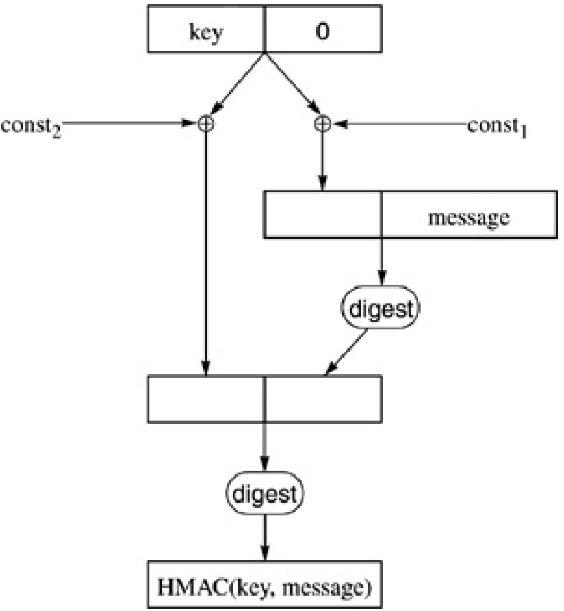
HMAC
HMAC has two phases
Phase 1: compute h(K1|message) = H
Phase 2: compute h(K2|H)
K1 and K2 are derived from K
HMAC pads the key to get 512bit key
If the key is longer than 512 bits, then the first 512 bits of the key are hashed, then the hash padded to 512 bits
Two constants are XORed to the padded key for the different operations
Does it solve the problem?

Slide 17
END

